Slide 1

Compiler Design
By-Chandana MN
20030141CSE060
ASSIGNED BY- DR. Shekhar R

Slide 2
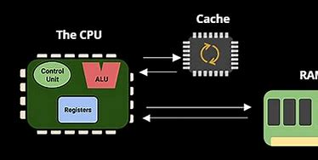
Develop of a cache optimization algorithm for a programming language

Slide 3
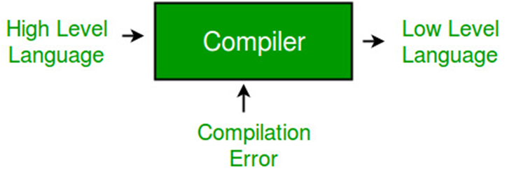
What is a Compiler
A compiler is a software program or tool that translates source code written in a high-level programming language into a lower-level representation that can be executed by a computer.
It takes the entire source code as input and produces an executable or binary file as output.
The primary function of a compiler is to convert human-readable code, which is typically written in languages like C, C++, Java, or Python, into a form that can be understood and executed by a computer's hardware.
This lower-level representation is usually machine code, which consists of instructions specific to the target processor or platform.

Slide 4
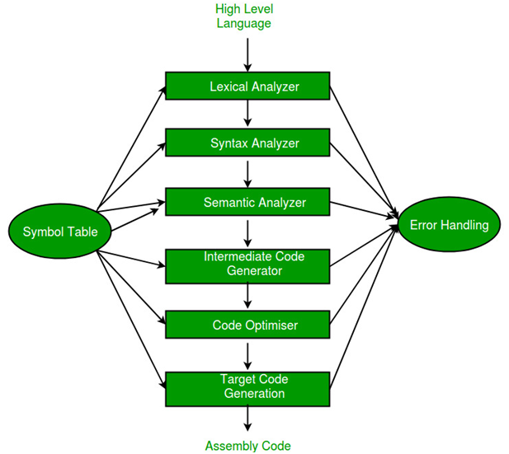
Steps involved in the compilation process

Slide 5
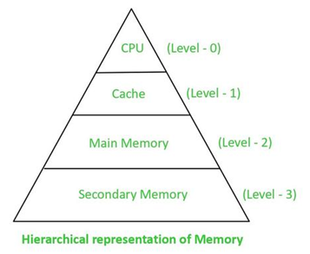
Memory Hierarchic

Slide 6
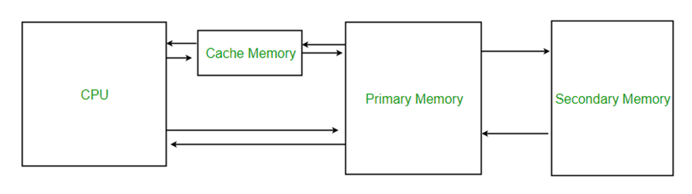
Introduction to Cache Memory
Cache memory plays a crucial role in improving the performance of computer systems by providing faster access to frequently used data.
It is a small, high-speed memory that sits between the central processing unit (CPU) and the main memory (RAM).
The primary purpose of cache memory is to reduce the average time required to access data from the main memory, which is slower compared to the CPU's processing speed.

Slide 7
Objective of Cache memory
Increased Access Speed
Improved CPU Utilization
Enhanced System Performance
Mitigation of Memory Bottlenecks
Efficient Memory Hierarchy

Slide 8
Develop of a cache optimization algorithm for a programming language
Developing a cache optimization algorithm for a programming language is a complex task.
It requires a deep understanding of the language, its memory access patterns, and the cache architecture.

Slide 9
Outline of the steps involved in developing cache optimization algorithm:
Analysis of Memory Access Patterns
Cache Behavior Analysis
Identify Optimization Opportunities
Algorithm Design
Implementation and Testing
Performance Evaluation and Refinement

Slide 10
Cache memory optimization methods
Spatial Locality Optimization
Temporal Locality Optimization
Cache Blocking
Cache Prefetching
Cache-conscious Data Structures
Compiler Optimizations
Data Alignment

Slide 11
Algorithms commonly used in cache optimization are:
Loop Blocking or Loop Tiling: Divides loop iterations into smaller blocks to improve cache utilization and data locality.
Loop Interchange: Swaps the order of nested loops to improve spatial locality and cache performance.
Loop Fusion: Combines multiple loops into a single loop to reduce loop overhead and improve cache efficiency.
Loop Unrolling: Expands loop iterations by a factor to increase instruction-level parallelism and reduce memory access latency.

Slide 12
Cont:
Loop Vectorization: Converts scalar loops into vectorized loops to exploit SIMD (Single Instruction, Multiple Data) instructions and improve cache utilization.
Loop Jamming: Combines multiple loop iterations into a single iteration to reduce loop overhead and enhance cache efficiency.
Loop Skewing: Adjusts the loop index variables to achieve better load balancing and reduce cache conflicts.

Slide 13
Cont:
Software Prefetching: Inserts explicit prefetching instructions in the code to bring data into the cache ahead of time and minimize cache misses.
Cache Blocking: Divides data into smaller blocks that fit within the cache to maximize cache utilization and reduce memory access latency.
Cache-Aware Matrix Multiplication: Optimizes matrix multiplication algorithms to exploit cache locality and minimize cache misses.

Slide 14
Loop blocking or loop tiling
Loop tiling, also known as loop blocking, is a loop transformation that exploits spatial and temporal locality of data accesses in loop nests.
This transformation allows data to be accessed in blocks (tiles), with the block size defined as a parameter of this transformation.
Each loop is transformed in two loops: one iterating inside each block (intratile) and the other one iterating over the blocks (intertile)

Slide 15
Code snippet
void optimizedMatrixMultiplication(int** A, int** B, int** C, int size) {
int blockSize = 32; // Size of each block
int i, j, k, ii, jj, kk;
for (i = 0; i < size; i += blockSize) {
for (j = 0; j < size; j += blockSize) {
for (k = 0; k < size; k += blockSize) {
// Process each block
for (ii = i; ii < i + blockSize; ii++) {
for (jj = j; jj < j + blockSize; jj++) {
for (kk = k; kk < k + blockSize; kk++) {
C[ii][jj] += A[ii][kk] * B[kk][jj];
} }}}}}}

Slide 16
Advantages
Improved Cache Utilization
Enhanced Locality
Reduced Memory Traffic
Parallelization Opportunities

Slide 17
Disadvantage
Increased Loop Overhead
Loop Blocking Overhead
Increased Code Complexity
Trade-off between Block Size and Cache Efficiency

Slide 18
Application
Scientific Computing
Image and Signal Processing
Video Games and Graphics
Database Systems
Compiler Design
Embedded Systems and IoT
High-Performance Computing

Slide 19
References
https://www.techtarget.com/whatis/definition/compiler#:~:text=A%20compiler%20is%20a%20special,as%20Java%20or%20C%2B%2B.
https://en.wikipedia.org/wiki/Compiler
https://www.geeksforgeeks.org/phases-of-a-compiler/
https://www.techtarget.com/searchstorage/definition/cache-memory#:~:text=Cache%20memory%20is%20a%20chip,can%20retrieve%20data%20from%20easily.
https://www.geeksforgeeks.org/cache-memory-in-computer-organization/
https://www.toppr.com/guides/computer-science/computer-fundamentals/primary-memory/cache-memory/
https://www.geeksforgeeks.org/basic-cache-optimization-techniques/
https://medium.com/@hritwik567/ten-advanced-optimizations-of-cache-performance-3c5323ce897f
https://www.aberdeen.com/blogposts/optimizing-cache-memory-performance-and-the-math-behind-it-all/
https://en.wikipedia.org/wiki/Loop_nest_optimization
https://www.sciencedirect.com/topics/computer-science/loop-tiling#:~:text=Loop%20tiling%2C%20also%20known%20as,a%20parameter%20of%20this%20transformation.
https://www.codee.com/knowledge/glossary-loop-tiling/
https://stackoverflow.com/questions/5444303/loop-unrolling-vs-loop-tiling
https://www.researchgate.net/publication/221131163_Impact_of_Loop_Tiling_on_the_Controller_Logic_of_Acceleration_Engines

Slide 20


